Slide 1








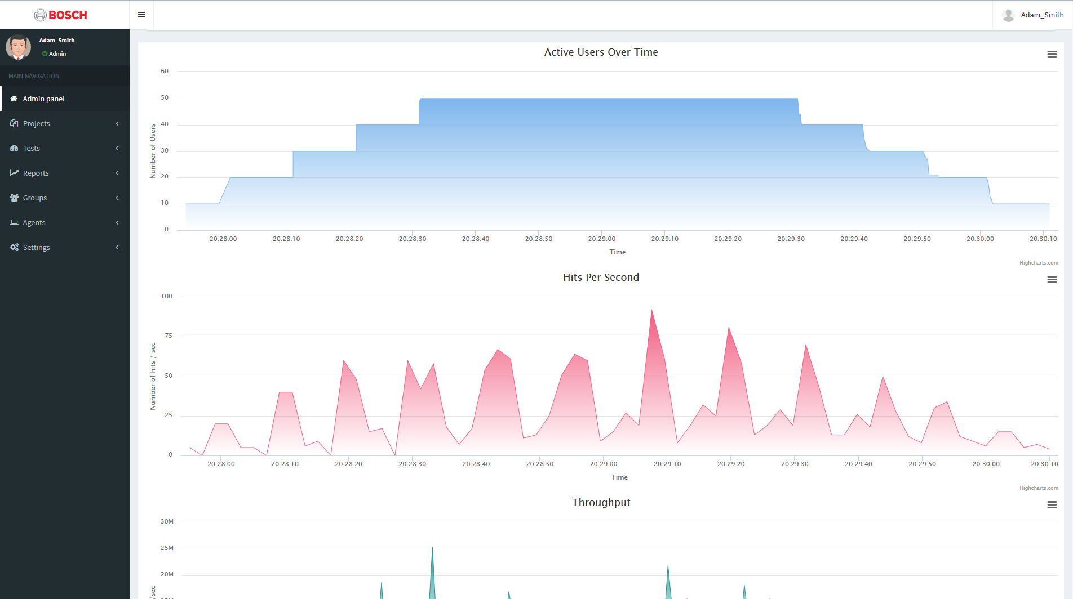
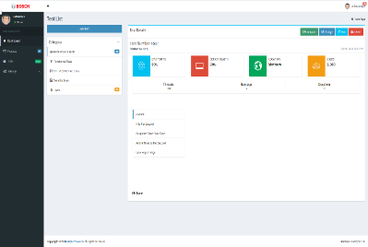





























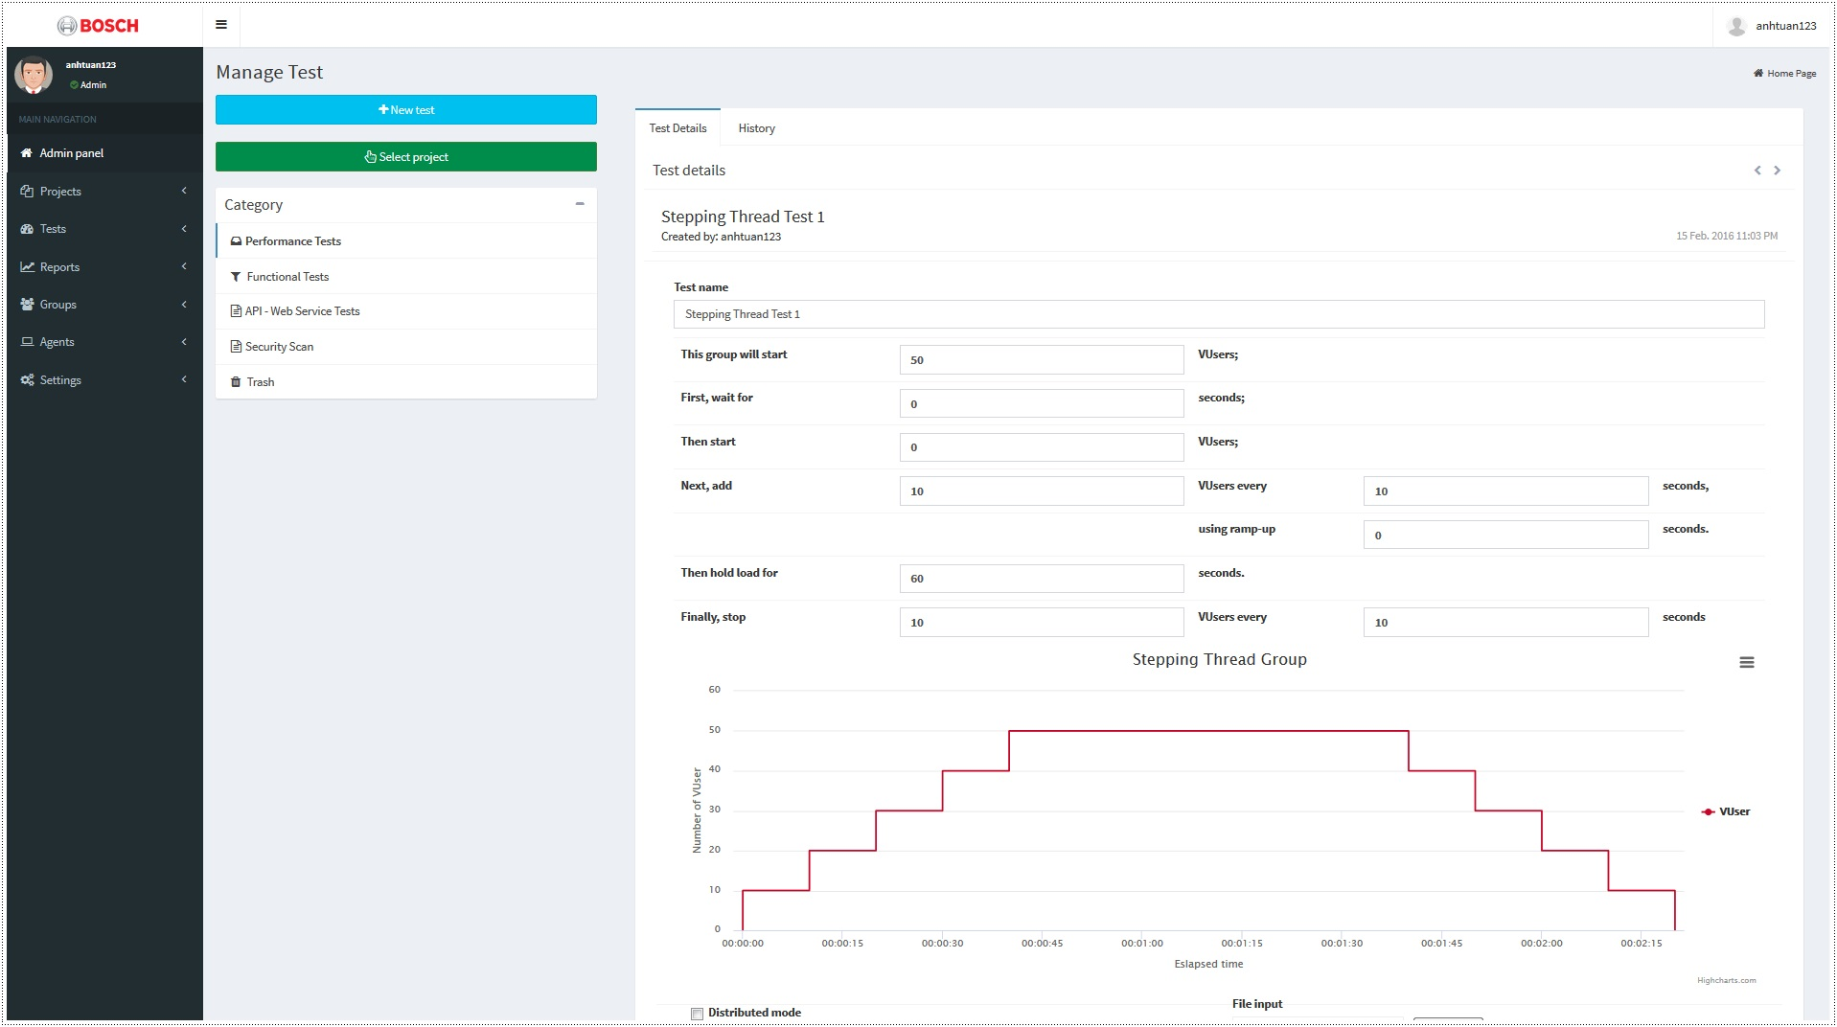
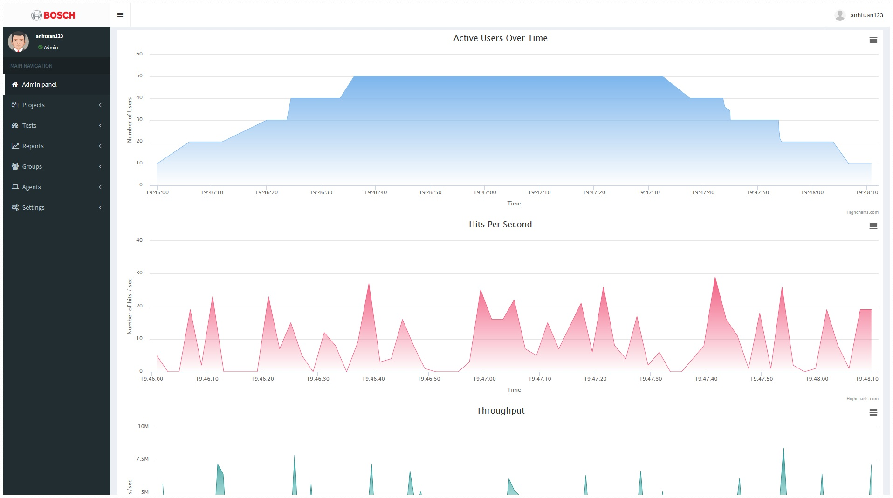
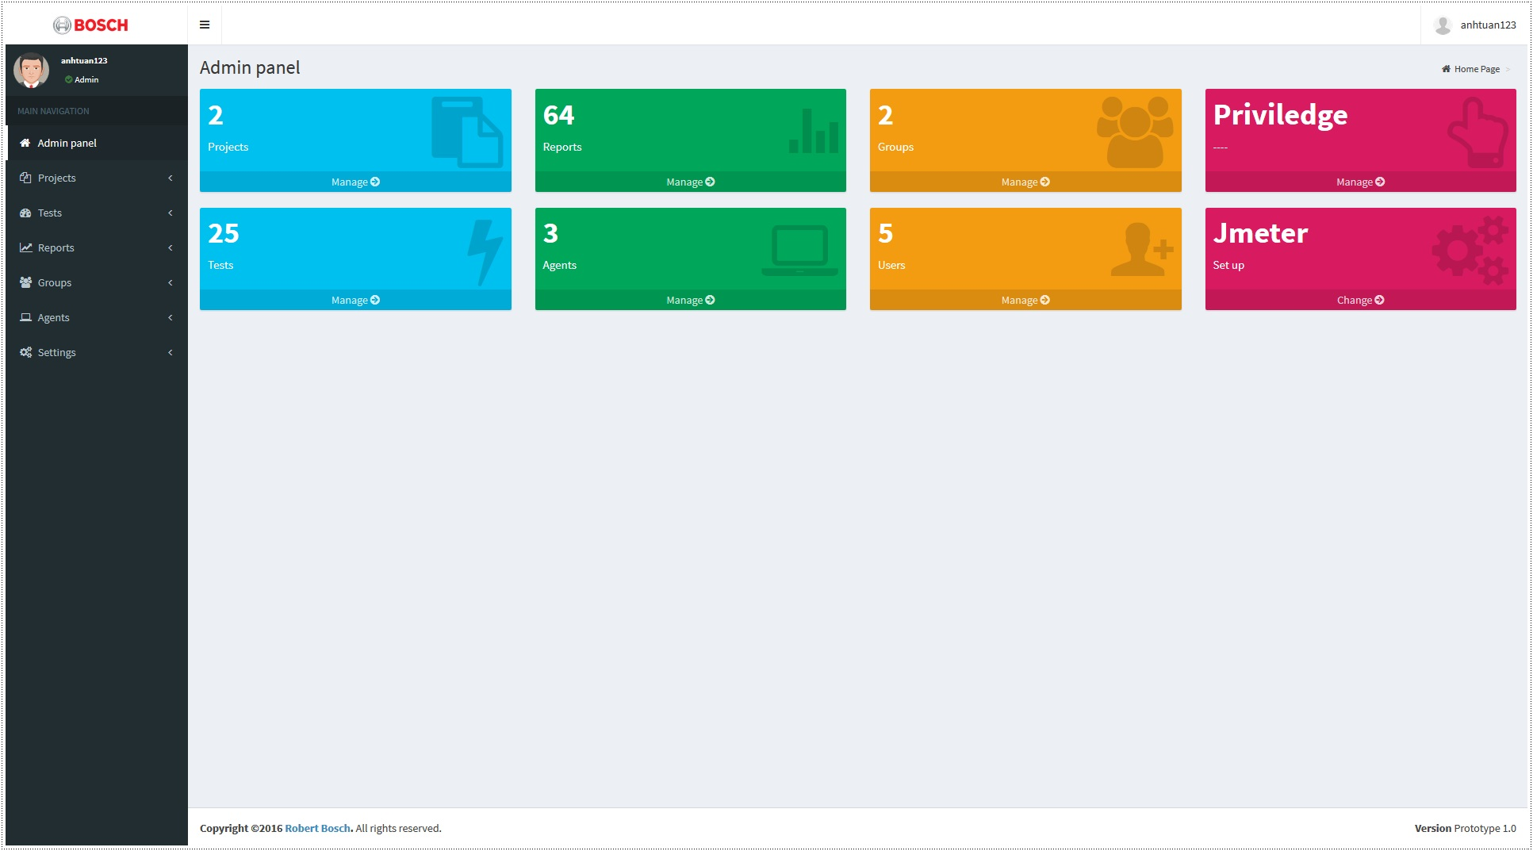
PERFORMANCE TESTING DASHBOARD
Research and Development Project
WHAT ARE OUR GOALS?
WHAT IS THE SOLUTION?
WHAT HAVE WE ACHIEVED?
Configure Jmeter on different machines
Project: Achieved all initial objectives and complete additional features.
Set up distributed system of agents
Manually extract reports to share
Experience: Non-stop learning and practicing during 8 months in professional environment.
Testers
Manually manage test scripts & reports
Agent
Skills: Improving soft skills and project management skills.
Centralized Hub – The Dashboard
Dashboard
Upload Jmeter script
Dashboard Server
Client: The platform becomes a stepping stone for client to implement their businesses
Manage Test Scripts
Manage Reports
Real-time
Report
Manage Users
Agent
Run Performance Test
Control Agent System
Target Service
WHAT ARE CHALLENGES?
Distributed System
Agent
Project: Build the application from scratch, first time apply Scrum Methodology
HOW DO WE DO THIS?
Technical: New to Spring Framework, Jmeter and Data Analysis
APPLY SCRUM METHODOLOGY
LAYERED STRUCTURE
TECHNOLOGY
Development
Sprint 4-14
Controller
REST Controller
Presentation
Communication: Misunderstanding
Preparation
Sprint 1-3
Analyze
Design
Implement
Review
Plan
Testing & Maintenance
Sprint 15-16
Templates
Views
Resources
Knowledge Acquisition
Solution Design
Testing
Go Live
Business
Engines
WHO ARE WE?
Service interfaces
Boot
Project
User
Test Case
Agent
Security
Configuration
Report Analysis
Data
Web MVC
Models
Project team
Dang Thi Thao My  Nguyen Anh Quan
Le Huynh Anh Tuan  Bui Nguyen Thien Khanh
Client
Mr. To Hoa Duy Man – Robert Bosch Engineering and Business Solutions Vietnam Co., Ltd
Supervisor
MSc. Truong Phuoc Loc – HCMC University of Science
QUALITY ASSURANCE
Repositories
Entities
Persistence
Requirements Development
Reviews
Post Delivery
Bug-fix
PRODUCT
Requirements Management
Verification
Validation
Testing
Design
Intergration
Coding
Test scenario
Performance report
Admin panel
www.itec.hcmus.edu.vn

